Slide 1
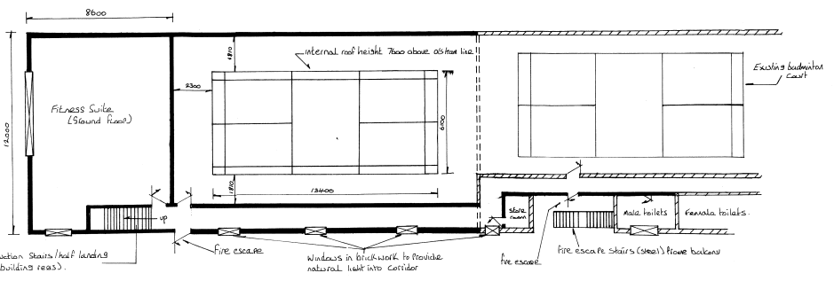
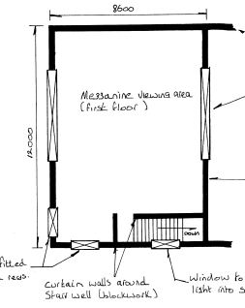
Recap: Plan View
https://www.dropbox.com/s/jlajom6gh0omo55/DASC%20Multi-use%20Hall%20Extension%20JP%20AGM.pptm?dl=0
https://www.dropbox.com/s/jlajom6gh0omo55/DASC%20Multi-use%20Hall%20Extension%20JP%20AGM.pptm?dl=0
https://www.dropbox.com/s/jlajom6gh0omo55/DASC%20Multi-use%20Hall%20Extension%20JP%20AGM.pptm?dl=0
Additional multi-use sports hall extending along perimeter wall
Mixed use room off second hall
Gym on mezzanine floor
Turnkey D&B solution
8 week shell completion estimate
Internal fitout using trades/in-house labour

Slide 2
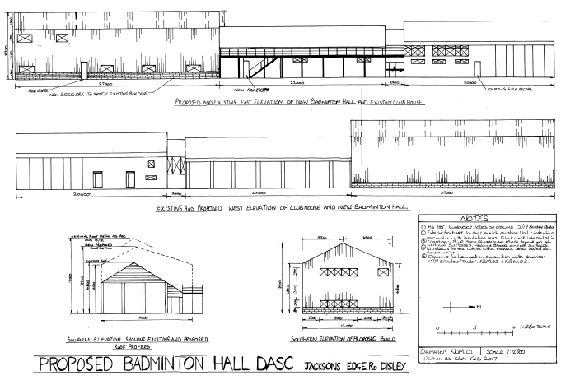
Recap: Front/Side Elevation

Slide 3
Comparison
Tender Comparison

Slide 4
High Peak Architects & The Sport Business
High Peak Architects
DASC has formally engaged the services of High Peak Architects to act as Principal Designer under the terms of the CDM regulations 2015 PD responsible for planning, managing, monitoring and coordinating health and safety in the pre-construction phase of a project.
We will work with HPA in the coming weeks as they undertake initial surveys at DASC
The project will be run by HPA who will proceed according to the 8 RIBA work stages
We currently sit between Preparation and Brief and Concept Design
Will resubmit the drawings once a full specification has been agreed internally
The Sport Business
At the same time we will re-engage the services of The Sport Business, a specialist consultancy which specialises in securing grants for small/voluntary sports organisations. I estimate we require in the region of £350k for a full turnkey solution. TSB have indicated they are confident we can raise upwards of 75% of this cost. The Total Cost of Ownership will be realised once tenders come back from appropriate contractors, and it will be up to us to provide the shortfall through fundraising activities. Suggestions for fundraising and alternative sources of funding are encouraged from all club members.
Both HPA and TSB have undertaken to invoice only for work undertaken. In this way the club limits its exposure to risk and unquantifiable expense.

Slide 5
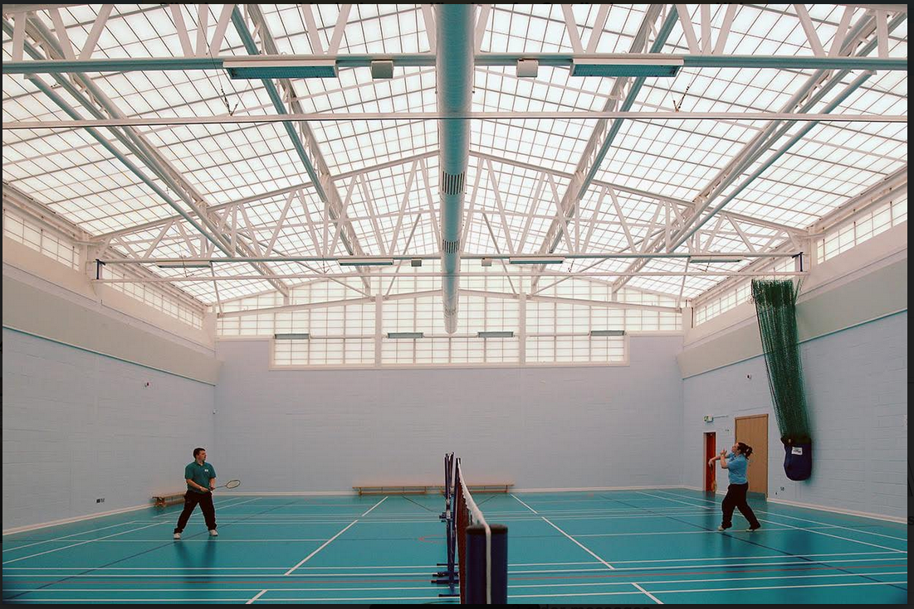
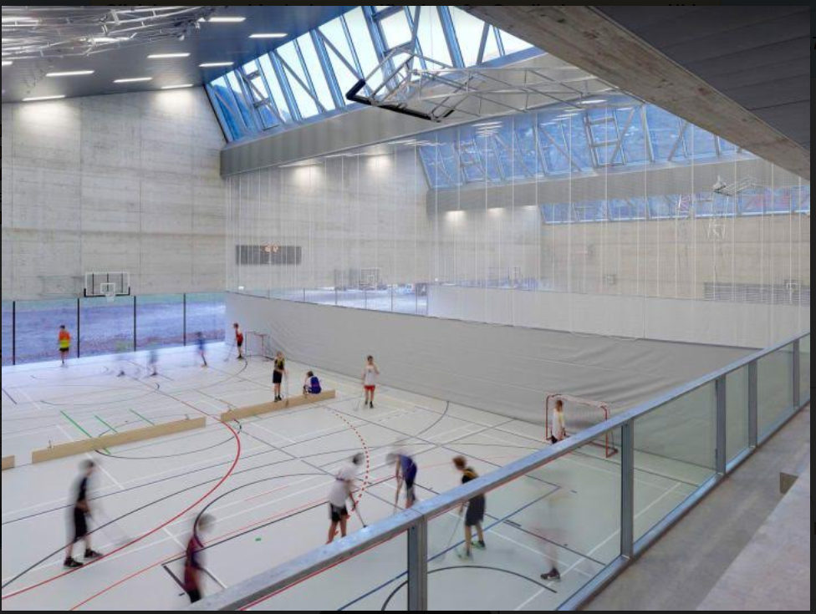
High Peak Architects: Overview
Specialise in educational, leisure & community buildings
Strong understanding of DASC aims & objectives
Best value for money
Work closely w/client
Local firm/staff
Established 2011
Imaginative & pragmatic designs

Slide 6
High Peak Architects: Northern Lawn TC, Didsbury

Slide 7
Next Steps
Consultation @ DASC /25/05
Re-engage The Sport Business
First site surveys by HPA
Proposals drafted in CAD and resubmitted for Planning approval

